Slide 1
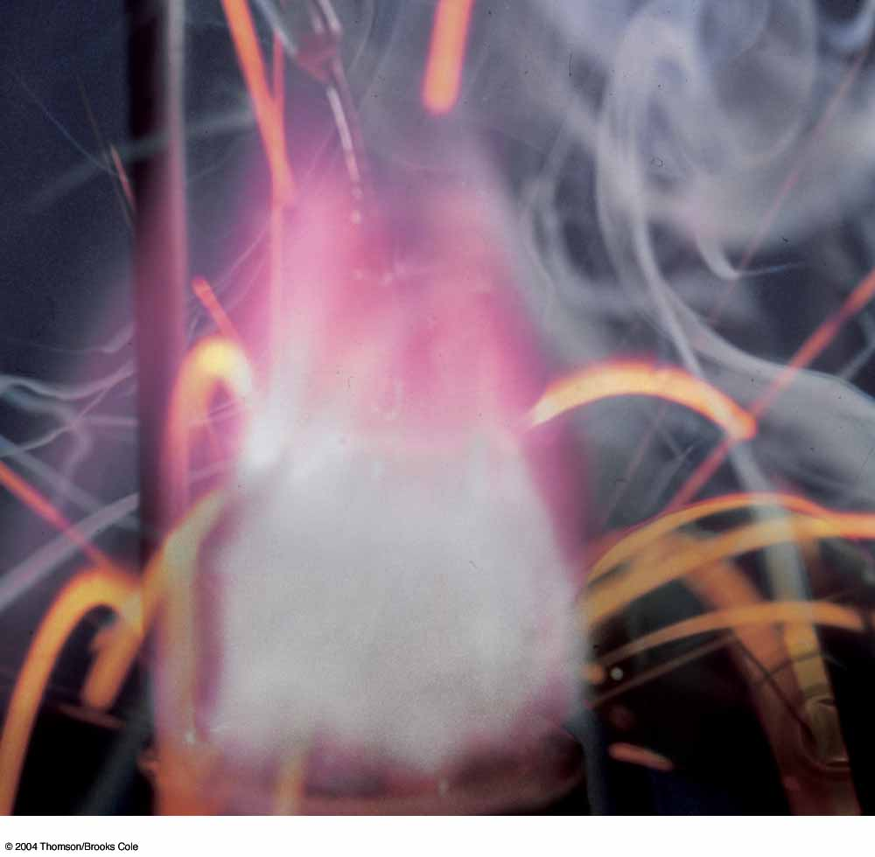
CHAPTER 4
Some Types of Chemical Reactions
Notes:
1
1

Slide 2
Chapter Four Goals
The Periodic Table: Metals, Nonmetals, and Metalloids
Aqueous Solutions: An Introduction
Reactions in Aqueous Solutions
Oxidation Numbers
Naming Some Inorganic Compounds
Naming Binary Compounds
Naming Ternary Acids and Their Salts
Classifying Chemical Reactions
Oxidation-Reduction Reactions: An Introduction
Combination Reactions
Decomposition Reactions
Displacement Reactions
Metathesis Reactions
Summary of Reaction Types
Synthesis Question
Notes:
2

Slide 3
The Periodic Table: Metals, Nonmetals, and Metalloids
1869 - Mendeleev & Meyer
  Discovered the periodic law
    The properties of the elements are periodic functions of their atomic numbers.
Notes:
3
3

Slide 4
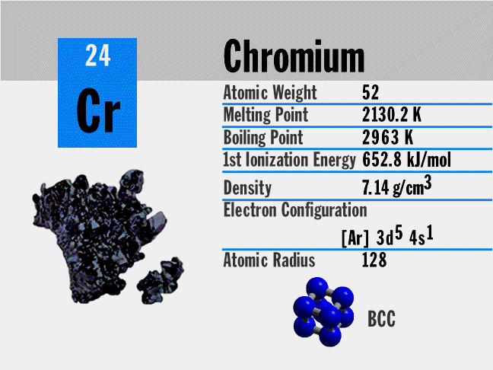
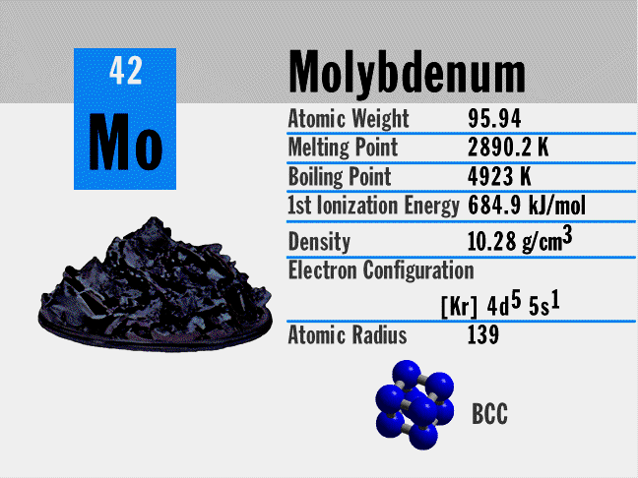
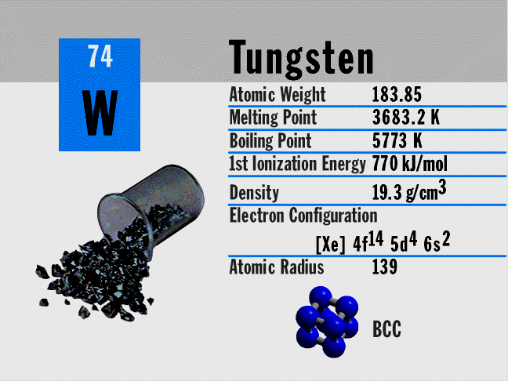
The Periodic Table: Metals, Nonmetals, and Metalloids
Groups or families
  Vertical group of elements on periodic table
  Similar chemical and physical properties
Notes:
3
3

Slide 5
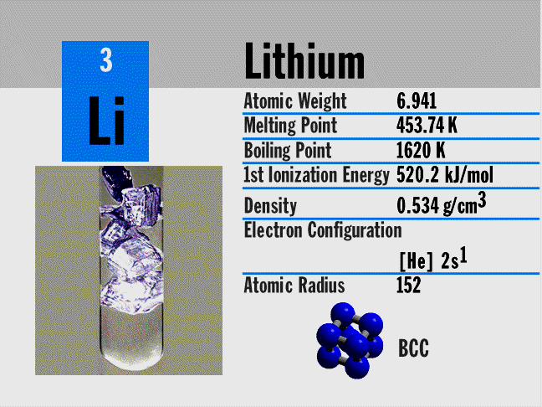
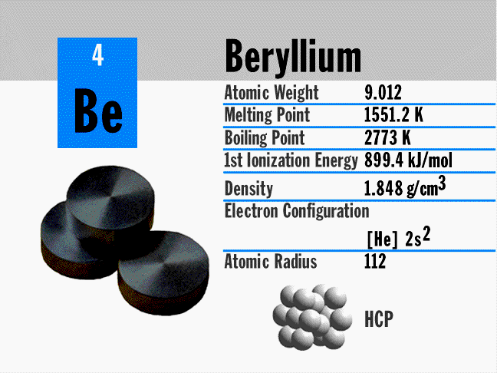
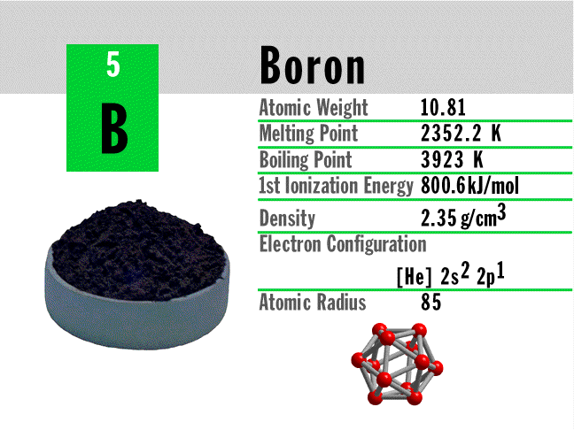
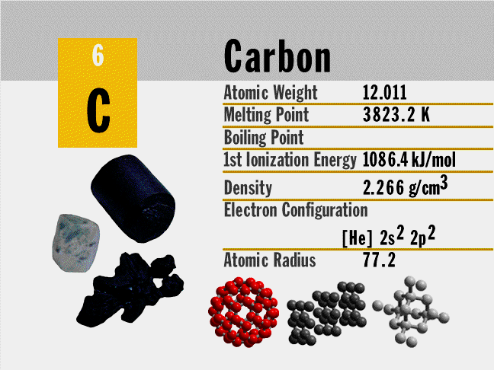
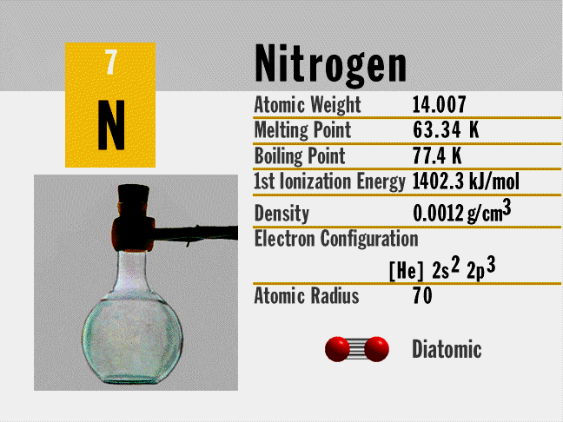
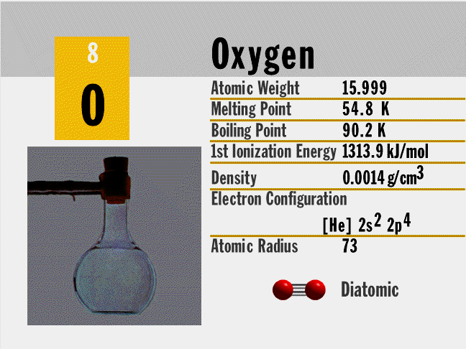
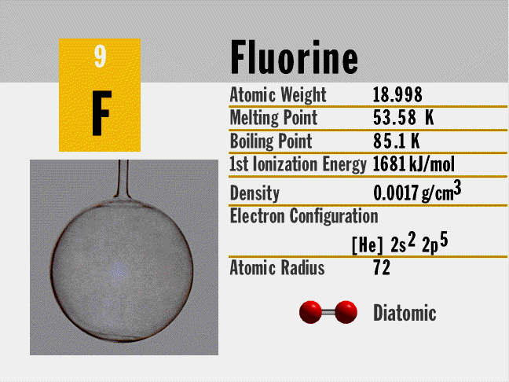
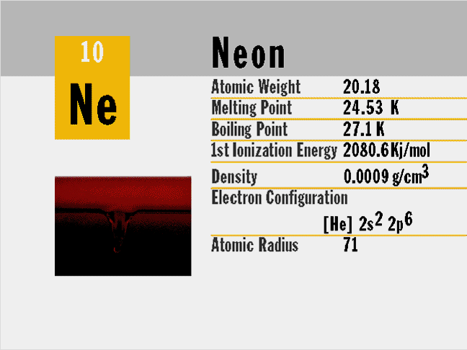
The Periodic Table: Metals, Nonmetals, and Metalloids
Period
  Horizontal group of elements on periodic table
  Transition from metals to nonmetals
Notes:
3
3

Slide 6
The Periodic Table: Metals, Nonmetals, and Metalloids
Some chemical properties of metals
Outer shells contain few electrons
Form cations by losing electrons
Form ionic compounds with nonmetals
Solid state characterized by metallic bonding

Slide 7
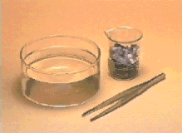

The Periodic Table: Metals, Nonmetals, and Metalloids
Group IA metals
  Li, Na, K, Rb, Cs, Fr
One example of a periodic trend
  The reactions with water of Li

Slide 8
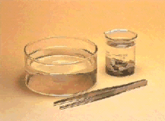
The Periodic Table: Metals, Nonmetals, and Metalloids
Group IA metals
  Li, Na, K, Rb, Cs, Fr
One example of a periodic trend
  The reactions with water of Li, Na

Slide 9
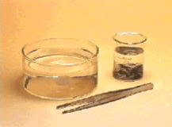
The Periodic Table: Metals, Nonmetals, and Metalloids
Group IA metals
  Li, Na, K, Rb, Cs, Fr
One example of a periodic trend
  The reactions with water of Li, Na, & K

Slide 10
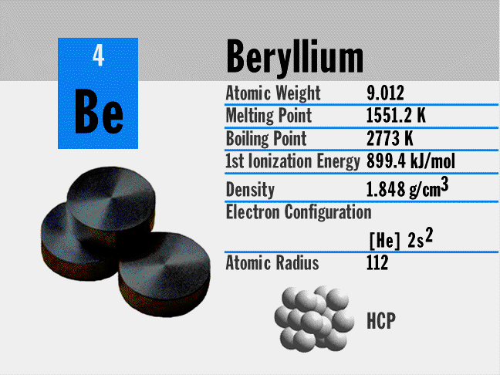
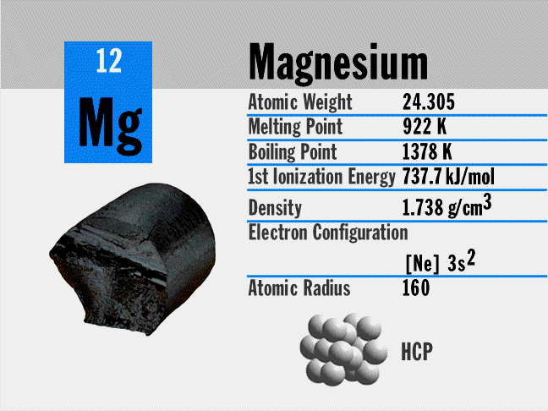
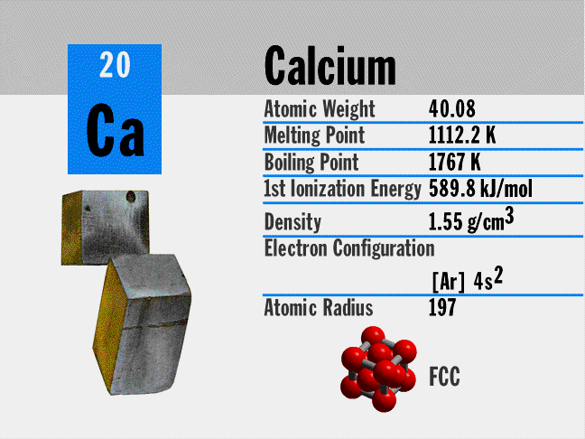
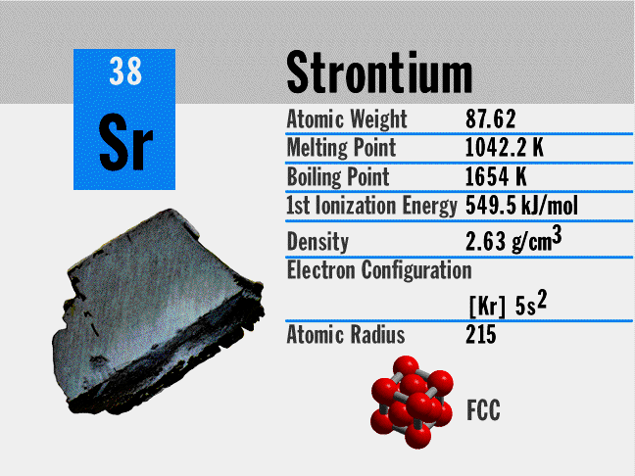
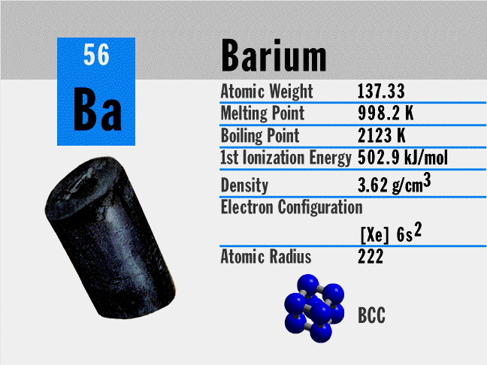
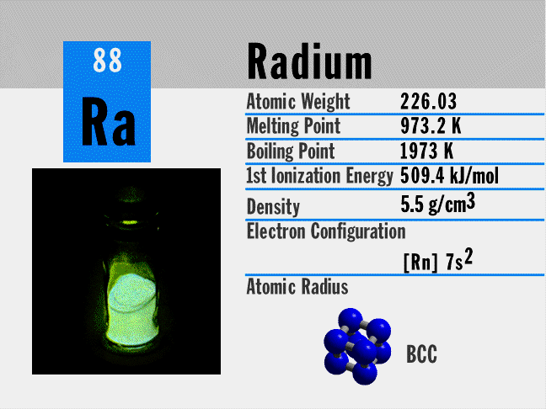
The Periodic Table: Metals, Nonmetals, and Metalloids
Group IIA metals
  alkaline earth metals
Be, Mg, Ca, Sr, Ba, Ra
Notes:
5
5

Slide 11
The Periodic Table: Metals, Nonmetals, and Metalloids
Some chemical properties of nonmetals
Outer shells contain four or more electrons
Form anions by gaining electrons
Form ionic compounds with metals and covalent compounds with other nonmetals
Form covalently bonded molecules; noble gases are monatomic

Slide 12
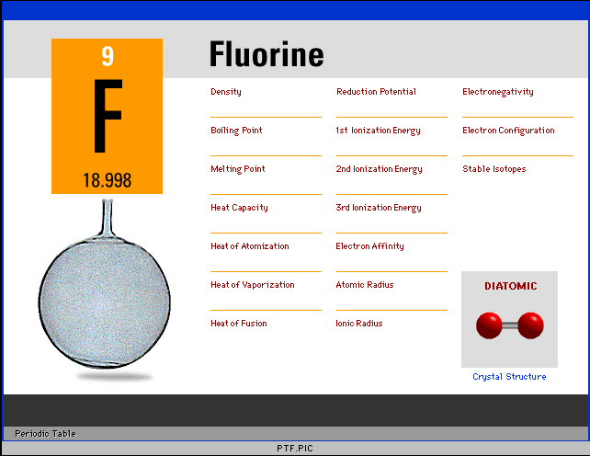
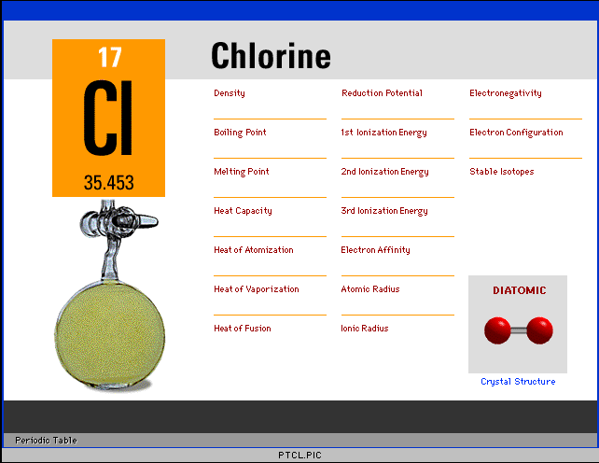
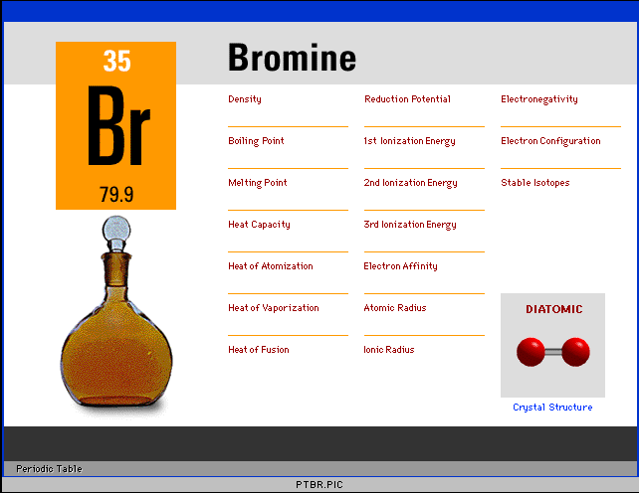
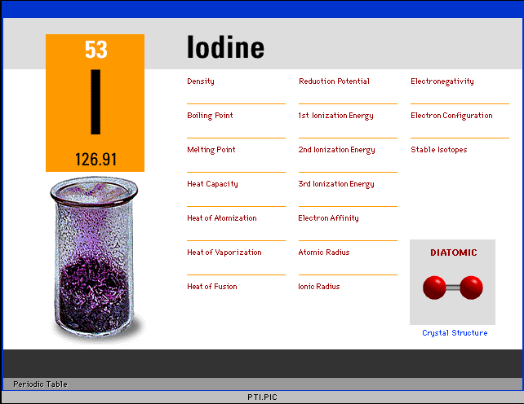
The Periodic Table: Metals, Nonmetals, and Metalloids
Group VIIA nonmetals
  halogens
  F, Cl, Br, I, At
Notes:
5
5

Slide 13
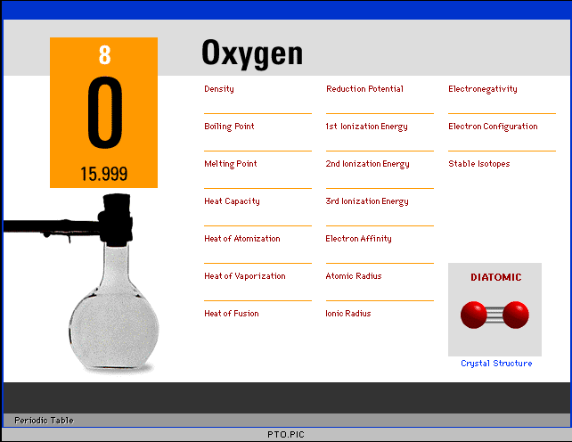
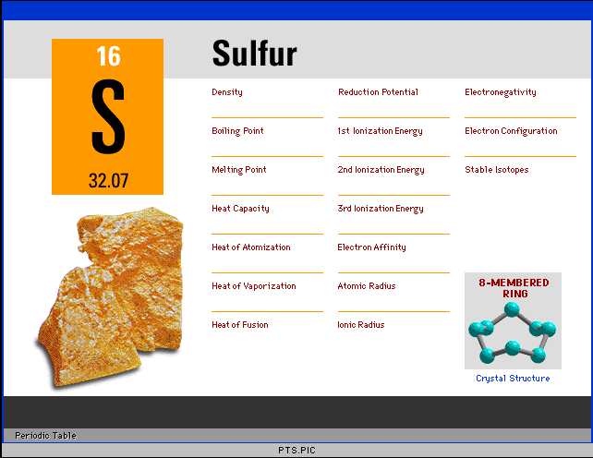
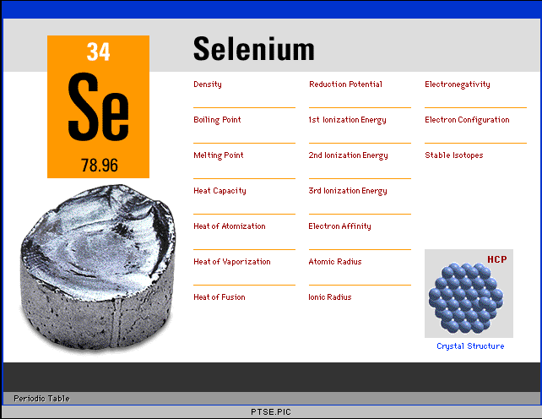
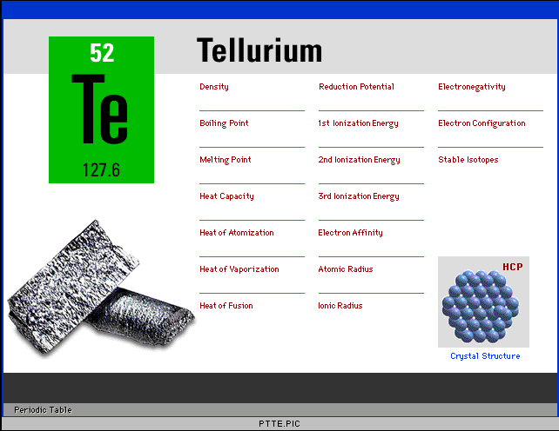
The Periodic Table: Metals, Nonmetals, and Metalloids
Group VIA nonmetals
  O, S, Se, Te
Notes:
5
5

Slide 14
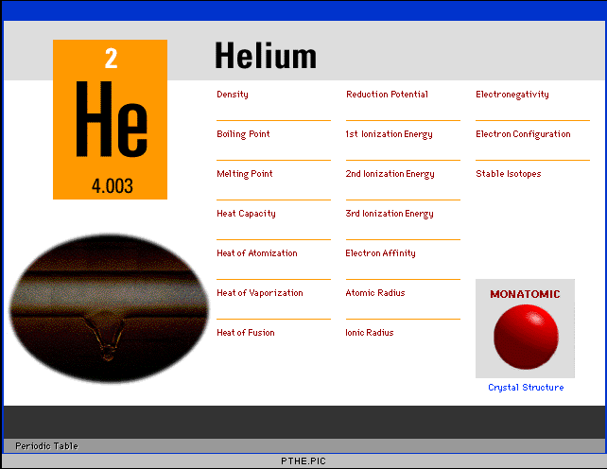
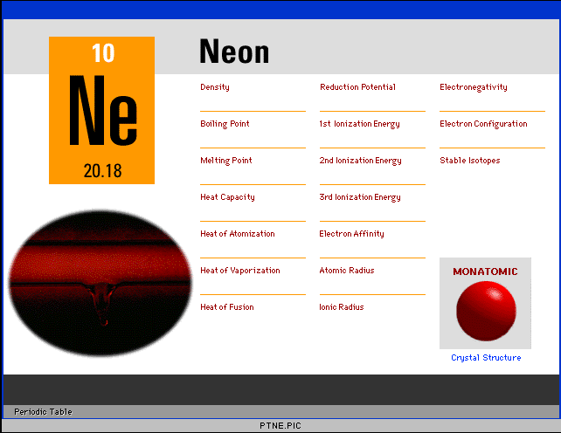
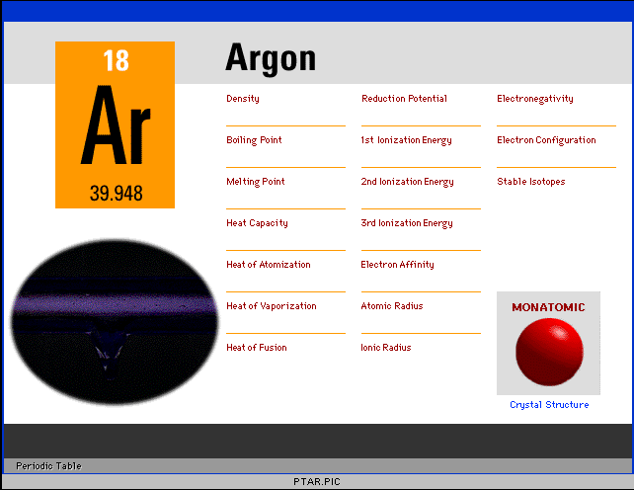
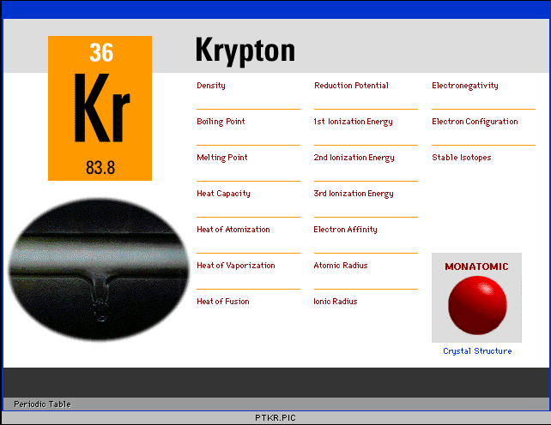
The Periodic Table: Metals, Nonmetals, and Metalloids
Group 0 nonmetals
  noble, inert or rare gases
  He, Ne, Ar, Kr, Xe, Rn
Notes:
5
5

Slide 15
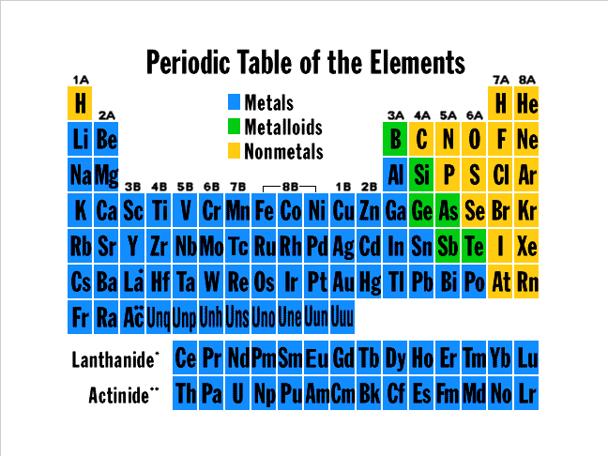
The Periodic Table: Metals, Nonmetals, and Metalloids
Stair step function on periodic table separates metals from nonmetals.
Metals are to the left of stair step.
  Approximately 80% of the elements
Best metals are on the far left of the table.
Notes:
7
7

Slide 16
The Periodic Table: Metals, Nonmetals, and Metalloids
Stair step function on periodic table separates metals from nonmetals.
Nonmetals are to the right of stair step.
  Approximately 20% of the elements
Best nonmetals are on the far right of the table.
Notes:
7
7

Slide 17
The Periodic Table: Metals, Nonmetals, and Metalloids
Stair step function on periodic table separates metals from nonmetals.
Metalloids have one side of the box on the stair step.
Notes:
7
7

Slide 18
The Periodic Table: Metals, Nonmetals, and Metalloids
Periodic trends in metallic character
Notes:
9
9

Slide 19
Aqueous Solutions: An Introduction
Electrolytes and Extent of Ionization
Aqueous solutions consist of a solute dissolved in water.
Classification of solutes:
  Nonelectrolytes – solutes that do not conduct electricity in water
Examples:
C₂H₅OH - ethanol
Notes:
10
10

Slide 20
Aqueous Solutions: An Introduction
C₆H₁₂O₆ - glucose (blood sugar)
Notes:
11
11

Slide 21
Aqueous Solutions: An Introduction
C₁₂H₂₂O₁₁ - sucrose (table sugar)
Notes:
12
12

Slide 22
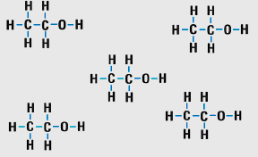
Aqueous Solutions: An Introduction
The reason nonelectrolytes do not conduct electricity is because they do not form ions in solution.
    ions conduct electricity in solution
Notes:
12
12

Slide 23
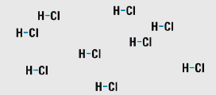
Aqueous Solutions: An Introduction
Classification of solutes
  strong electrolytes - conduct electricity extremely well in dilute aqueous solutions
Examples of strong electrolytes
HCl, HNO₃, etc.
    strong soluble acids
NaOH, KOH, etc.
    strong soluble bases
NaCl, KBr, etc.
    soluble ionic salts
    ionize in water essentially 100%
Notes:
13
13

Slide 24
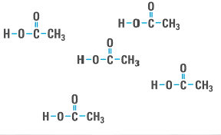
Aqueous Solutions: An Introduction
Classification of solutes
  weak electrolytes - conduct electricity poorly in dilute aqueous solutions
CH₃COOH, (COOH)₂
    weak acids
Notes:
14
14

Slide 25
Aqueous Solutions: An Introduction
NH₃, Fe(OH)₃
    weak bases
some soluble covalent salts
    ionize in water much less than 100%
Notes:
14
14

Slide 26
Aqueous Solutions: An Introduction
Strong and Weak Acids
Acids are substances that generate H⁺ in aqueous solutions.
Strong acids ionize 100% in water.
Notes:
15
15

Slide 27
Aqueous Solutions: An Introduction
Strong and Weak Acids
Acids are substances that generate H⁺ in aqueous solutions.
Strong acids ionize 100% in water.
Notes:
15
15

Slide 28
Aqueous Solutions: An Introduction
Some Strong Acids and Their Anions
Formula Name
HCl hydrochloric acid
HBr hydrobromic acid
HI hydroiodic acid
HNO₃ nitric acid
H₂SO₄ sulfuric acid
HClO₃ chloric acid
HClO₄ perchloric acid
Notes:
16
16

Slide 29
Aqueous Solutions: An Introduction
Some Strong Acids and Their Anions
Acid Anion Name
HCl Cl⁻ chloride ion
HBr Br⁻ bromide ion
HI I⁻ iodide ion
HNO₃ NO₃⁻ nitrate ion
H₂SO₄ SO₄²⁻ sulfate ion
HClO₃ ClO₃⁻ chlorate ion
HClO₄ ClO₄⁻ perchlorate ion
Notes:
16
16

Slide 30
Aqueous Solutions: An Introduction
Weak acids ionize significantly less than 100% in water.
  Typically ionize 10% or less!
Notes:
17
17

Slide 31
Aqueous Solutions: An Introduction
Some Common Weak Acids and Their Anions
Formula Name
HF hydrofluoric acid
CH₃COOH acetic acid (vinegar)
HCN hydrocyanic acid
HNO₂ nitrous acid
H₂CO₃ carbonic acid (soda water)
H₂SO₃ sulfurous acid
H₃PO₄ phosphoric acid
(COOH)₂ oxalic acid
Notes:
17
17

Slide 32
Aqueous Solutions: An Introduction
Some Common Weak Acids and Their Anions
Acid Anion Name
HF F⁻ fluoride ion
CH₃COOH CH₃COO⁻ acetate ion
HCN CN⁻ cyanide ion
HNO₂ NO₂⁻ nitrite ion
H₂CO₃ CO₃²⁻ carbonate ion
H₂SO₃ SO₃²⁻ sulfite ion
H₃PO₄ PO₄³⁻ phosphate ion
(COOH)₂ (COO)₂²⁻ oxalate ion
Notes:
17
17

Slide 33
Aqueous Solutions: An Introduction
Reversible Reactions
CH₃COOH acetic acid
Notes:
18
18

Slide 34
Aqueous Solutions: An Introduction
All weak inorganic acids ionize reversibly or in equilibrium reactions.
  This is why they ionize less than 100%.
CH₃COOH – structure of acetic acid
Notes:
18
18

Slide 35
Aqueous Solutions: An Introduction
Correct chemical symbolism for equilibrium reactions
Notes:
18
18

Slide 36
Aqueous Solutions: An Introduction
Strong Bases, Insoluble Bases, and Weak Bases
Characteristic of common inorganic bases is that they produce OH- ions in solution.
Notes:
19
19

Slide 37
Aqueous Solutions: An Introduction
Common Strong Bases
Formula Name
LiOH lithium hydroxide
NaOH sodium hydroxide
KOH potassium hydroxide
RbOH rubidium hydroxide
CsOH cesium hydroxide
Ca(OH)₂ calcium hydroxide
Sr(OH)₂ strontium hydroxide
Ba(OH)₂ barium hydroxide
Notice that they are all hydroxides of IA and IIA metals
Notes:
20
20

Slide 38
Aqueous Solutions: An Introduction
Similarly to strong acids, strong bases ionize 100% in water.
Notes:
19
19

Slide 39
Aqueous Solutions: An Introduction
Insoluble or sparingly soluble bases
  Ionic compounds that are insoluble in water, consequently, not very basic.
Formula Name
Cu(OH)₂ copper (II) hydroxide
Fe(OH)₂ iron (II) hydroxide
Fe(OH)₃ iron (III) hydroxide
Zn(OH)₂ zinc (II) hydroxide
Mg(OH)₂ magnesium hydroxide
Notes:
21
21

Slide 40
Aqueous Solutions: An Introduction
Weak bases are covalent compounds that ionize slightly in water.
Ammonia is most common weak base
  NH₃
Notes:
22
22

Slide 41
Aqueous Solutions: An Introduction
Weak bases are covalent compounds that ionize slightly in water.
Ammonia is most common weak base
  NH₃
Notes:
22
22

Slide 42
Aqueous Solutions: An Introduction
Solubility Guidelines for Compounds in Aqueous Solutions
  It is very important that you know these guidelines and how to apply them in reactions.
Common inorganic acids and low-molecular-weight organic acids are water soluble.
All common compounds of the Group IA metal ions and the ammonium ion are water soluble.
  Li⁺, Na⁺, K⁺, Rb⁺, Cs⁺, and NH₄⁺
Notes:
23
23

Slide 43
Aqueous Solutions: An Introduction
Common nitrates, acetates, chlorates, and perchlorates are water soluble.
  NO₃⁻, CH₃COO⁻, ClO₃⁻, and ClO₄⁻
Common chlorides are water soluble.
  Exceptions – AgCl, Hg₂Cl₂, & PbCl₂
  Common bromides and iodides behave similarly to chlorides.
  Common fluorides are water soluble.
    Exceptions – MgF₂, CaF₂, SrF₂, BaF₂, and PbF₂
Notes:
23
23

Slide 44
Aqueous Solutions: An Introduction
Common sulfates are water soluble.
  Exceptions – PbSO₄, BaSO₄, & HgSO₄
  Moderately soluble – CaSO₄, SrSO₄, & Ag₂SO₄
Common metal hydroxides are water insoluble.
  Exceptions – LiOH, NaOH, KOH, RbOH & CsOH
  Common bromides and iodides behave similarly to chlorides.
  Common fluorides are water soluble.
    Exceptions – MgF₂, CaF₂, SrF₂, BaF₂, and PbF₂
Notes:
23
23

Slide 45
Aqueous Solutions: An Introduction
Common carbonates, phosphates, and arsenates are water insoluble.
  CO₃²⁻, PO₄³⁻, & AsO₄³⁻
  Exceptions- IA metals and NH₄⁺ plus
    Ca to Ba
  Moderately soluble – MgCO₃
Common sulfides are water insoluble.
  Exceptions – IA metals and NH₄⁺ plus
    IIA metals
Notes:
23
23

Slide 46
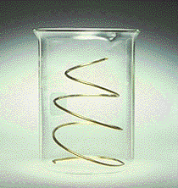
Reactions in
Aqueous Solutions
Symbolic representation of what is happening at the laboratory and molecular levels in aqueous solutions.
  Copper reacting with silver nitrate.
Laboratory level
Notes:
24
24

Slide 47
Reactions in
Aqueous Solutions
Symbolic representation of what is happening at the laboratory and molecular levels in aqueous solutions.
  Copper reacting with silver nitrate.
Symbolic representation
Notes:
24
24

Slide 48
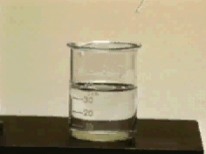
Reactions in
Aqueous Solutions
Another example of aqueous reactions.
  Sodium chloride reacting with silver nitrate.
Laboratory level
Notes:
24
24

Slide 49
Reactions in
Aqueous Solutions
Another example of aqueous reactions.
  Sodium chloride reacting with silver nitrate.
Symbolic representation
Notes:
24
24

Slide 50
Reactions in
Aqueous Solutions
There are three ways to write reactions in aqueous solutions.
Molecular equation
  Show all reactants & products in molecular or ionic form
Total ionic equation
  Show the ions and molecules as they exist in solution
Notes:
24
24

Slide 51
Reactions in
Aqueous Solutions
Net ionic equation
  Shows ions that participate in reaction and removes spectator ions.
Spectator ions do not participate in the reaction.
Notes:
25
25

Slide 52
Reactions in
Aqueous Solutions
Look in total ionic equation for species that do not change from reactant to product.
  Spectator ions in < >’s.
Net ionic equation
Notes:
25
25

Slide 53
Reactions in
Aqueous Solutions
In the total and net ionic equations the only common substances that should be written as ions are:
  Strong acids
  Strong bases
  Soluble ionic salts
Notes:
25
25

Slide 54
Oxidation Numbers
Guidelines for assigning oxidation numbers.
The oxidation number of any free, uncombined element is zero.
The oxidation number of an element in a simple (monatomic) ion is the charge on the ion.
In the formula for any compound, the sum of the oxidation numbers of all elements in the compound is zero.
In a polyatomic ion, the sum of the oxidation numbers of the constituent elements is equal to the charge on the ion.

Slide 55
Oxidation Numbers
Fluorine has an oxidation number of –1 in its compounds.
Hydrogen, H, has an oxidation number of +1 unless it is combined with metals, where it has the oxidation number -1.
  Examples – LiH, BaH₂
Oxygen usually has the oxidation number -2.
  Exceptions:
  In peroxides O has oxidation number of –1.
    Examples - H₂O₂, CaO₂, Na₂O₂
  In OF₂ O has oxidation number of +2.

Slide 56
Oxidation Numbers
Use the periodic table to help with assigning oxidation numbers of other elements.
  IA metals have oxidation numbers of +1.
  IIA metals have oxidation numbers of +2.
  IIIA metals have oxidation numbers of +3.
    There are a few rare exceptions.
  VA elements have oxidation numbers of –3 in binary compounds with H, metals or NH₄⁺.
  VIA elements below O have oxidation numbers of –2 in binary compounds with H, metals or NH₄⁺.
Summary in Table 4-10.

Slide 57
Oxidation Numbers
Example 4-1: Assign oxidation numbers to each element in the following compounds:
NaNO₃
Na = +1 (Rule 8)
O = -2 (Rule 7)
N = +5
  Calculate using rule 3.
  +1 + 3(-2) + x = 0
  x = +5
Notes:
36
36

Slide 58
Oxidation Numbers
K₂Sn(OH)₆
K = +1 (Rule 8)
O = -2 (Rule 7)
H = +1 (Rule 6)
Sn = +5
  Calculate using rule 3.
  2(+1) + 6(-2) + 6(+1) + x = 0
  x = +5
Notes:
36
36

Slide 59
Oxidation Numbers
H₃PO₄
You do it!
H = +1
O = -2
P = +5
Notes:
36
36

Slide 60
Oxidation Numbers
SO₃²⁻
O = -2 (Rule 7)
S = +4
  Calculate using rule 4.
  3(-2) + x = -2
  x = +4
Notes:
38
38

Slide 61
Oxidation Numbers
HCO₃⁻
O = -2 (Rule 7)
H = +1 (Rule 6)
C = +4
  Calculate using rule 4.
  +1 + 3(-2) + x = -1
  x = +4
Notes:
38
38

Slide 62
Oxidation Numbers
Cr₂O₇²⁻
You do it!
O = -2
Cr = +6
Notes:
39
39

Slide 63
Naming Some
Inorganic Compounds
Binary compounds are made of two elements.
  metal + nonmetal = ionic compound
  nonmetal + nonmetal = covalent compound
Name the more metallic element first.
  Use the element’s name.
Name the less metallic element second.
  Add the suffix “ide” to the element’s stem.
Notes:
51
51

Slide 64
Naming Some
Inorganic Compounds
Nonmetal Stems
Element Stem
Boron bor
Carbon carb
Silicon silic
Nitrogen nitr
Phosphorus phosph
Arsenic arsen
Antimony antimon

Slide 65
Naming Some
Inorganic Compounds
Oxygen ox
Sulfur sulf
Selenium selen
Tellurium tellur
Phosphorus phosph
Hydrogen hydr

Slide 66
Naming Some
Inorganic Compounds
Fluorine fluor
Chlorine chlor
Bromine brom
Iodine iod

Slide 67
Naming Some
Inorganic Compounds
Binary Ionic Compounds are made of a metal cation and a nonmetal anion.
  Cation named first
  Anion named second
LiBr lithium bromide
MgCl₂ magnesium chloride
Li₂S lithium sulfide
Al₂O₃ You do it!
Notes:
52
52

Slide 68
Naming Some
Inorganic Compounds
LiBr lithium bromide
MgCl₂ magnesium chloride
Li2S lithium sulfide
Al₂O₃ aluminum oxide
Na₃P You do it!
Notes:
52
52

Slide 69
Naming Some
Inorganic Compounds
LiBr lithium bromide
MgCl₂ magnesium chloride
Li₂S lithium sulfide
Al₂O₃ aluminum oxide
Na₃P sodium phosphide
Mg₃N₂ You do it!
Notes:
52
52

Slide 70
Naming Some
Inorganic Compounds
LiBr lithium bromide
MgCl₂ magnesium chloride
Li₂S lithium sulfide
Al₂O₃ aluminum oxide
Na₃P sodium phosphide
Mg₃N₂ magnesium nitride
Notice that binary ionic compounds with metals having one oxidation state (representative metals) do not use prefixes or Roman numerals.
Notes:
52
52

Slide 71
Naming Some
Inorganic Compounds
Binary ionic compounds containing metals that exhibit more than one oxidation state
Metals exhibiting multiple oxidation states are:
  most of the transition metals
  metals in groups IIIA (except Al), IVA, & VA
Notes:
53
53

Slide 72
Naming Some
Inorganic Compounds
There are two methods to name these compounds.
Older method
  add suffix “ic” to element’s Latin name for higher oxidation state
  add suffix “ous” to element’s Latin name for lower oxidation state
Modern method
  use Roman numerals in parentheses to indicate metal’s oxidation state
Notes:
53
53

Slide 73
Naming Some
Inorganic Compounds
Compound Old System Modern System
FeBr₂ ferrous bromide iron(II) bromide
FeBr₃ ferric bromide iron(III) bromide
SnO stannous oxide tin(II) oxide
SnO₂ stannic oxide tin(IV) oxide
TiCl₂ You do it!
Notes:
54
54

Slide 74
Naming Some
Inorganic Compounds
Compound Old System Modern System
FeBr₂ ferrous bromide iron(II) bromide
FeBr₃ ferric bromide iron(III) bromide
SnO stannous oxide tin(II) oxide
SnO₂ stannic oxide tin(IV) oxide
TiCl₂ titanous chloride titanium(II) chloride
TiCl₃ You do it!
Notes:
54
54

Slide 75
Naming Some
Inorganic Compounds
Compound Old System Modern System
FeBr₂ ferrous bromide iron(II) bromide
FeBr₃ ferric bromide iron(III) bromide
SnO stannous oxide tin(II) oxide
SnO₂ stannic oxide tin(IV) oxide
TiCl₂ titanous chloride titanium(II) chloride
TiCl₃ titanic chloride titanium(III) chloride
TiCl₄ You do it!
Notes:
54
54

Slide 76
Naming Some
Inorganic Compounds
Compound Old System Modern System
FeBr₂ ferrous bromide iron(II) bromide
FeBr₃ ferric bromide iron(III) bromide
SnO stannous oxide tin(II) oxide
SnO₂ stannic oxide tin(IV) oxide
TiCl₂ titanous chloride titanium(II) chloride
TiCl₃ titanic chloride titanium(III) chloride
TiCl₄ does not work titanium(IV) chloride
Notes:
54
54

Slide 77
Naming Some
Inorganic Compounds
Pseudobinary ionic compounds
There are three polyatomic ions that commonly form binary ionic compounds.
  OH⁻ hydroxide
  CN⁻ cyanide
  NH₄⁺ ammonium
Use binary ionic compound naming system.
KOH potassium hydroxide
Ba(OH)₂ barium hydroxide
Al(OH)₃ aluminum hydroxide
Fe(OH)₂ You do it!
Notes:
64
64

Slide 78
Naming Some
Inorganic Compounds
KOH potassium hydroxide
Ba(OH)₂ barium hydroxide
Al(OH)₃ aluminum hydroxide
Fe(OH)₂ iron (II) hydroxide
Fe(OH)₃ You do it!
Notes:
64
64

Slide 79
Naming Some
Inorganic Compounds
KOH potassium hydroxide
Ba(OH)₂ barium hydroxide
Al(OH)₃ aluminum hydroxide
Fe(OH)₂ iron (II) hydroxide
Fe(OH)₃ iron (III) hydroxide
Ba(CN)₂ You do it!
Notes:
64
64

Slide 80
Naming Some
Inorganic Compounds
KOH potassium hydroxide
Ba(OH)₂ barium hydroxide
Al(OH)₃ aluminum hydroxide
Fe(OH)₂ iron (II) hydroxide
Fe(OH)₃ iron (III) hydroxide
Ba(CN)₂ barium cyanide
(NH₄)₂S You do it!
Notes:
64
64

Slide 81
Naming Some
Inorganic Compounds
KOH potassium hydroxide
Ba(OH)₂ barium hydroxide
Al(OH)₃ aluminum hydroxide
Fe(OH)₂ iron (II) hydroxide
Fe(OH)₃ iron (III) hydroxide
Ba(CN)₂ barium cyanide
(NH₄)₂S ammonium sulfide
NH₄CN You do it!
Notes:
64
64

Slide 82
Naming Some
Inorganic Compounds
KOH potassium hydroxide
Ba(OH)₂ barium hydroxide
Al(OH)₃ aluminum hydroxide
Fe(OH)₂ iron (II) hydroxide
Fe(OH)₃ iron (III) hydroxide
Ba(CN)₂ barium cyanide
(NH₄)₂S ammonium sulfide
NH₄CN ammonium cyanide
Notes:
64
64

Slide 83
Naming Some
Inorganic Compounds
Binary Acids are binary compounds consisting of hydrogen and a nonmetal.
Compounds are usually gases at room temperature and pressure.
  Nomenclature for the gaseous compounds is hydrogen (stem)ide.
When the compounds are dissolved in water they form acidic solutions.
  Nomenclature for the acidic solutions is
  hydro (stem)ic acid.
Notes:
55
55

Slide 84
Naming Some
Inorganic Compounds
Formula Name Aqueous Solution
HF hydrogen fluoride hydrofluoric acid
HCl hydrogen chloride hydrochloric acid
HBr hydrogen bromide hydrobromic acid
H₂S You do it!
Notes:
56
56

Slide 85
Naming Some
Inorganic Compounds
Formula Name Aqueous solution
HF hydrogen fluoride hydrofluoric acid
HCl hydrogen chloride hydrochloric acid
HBr hydrogen bromide hydrobromic acid
H₂S hydrogen sulfide hydrosulfuric acid
Notes:
56
56

Slide 86
Naming Some
Inorganic Compounds
Binary covalent molecular compounds composed of two nonmetals other than hydrogen
  Nomenclature must include prefixes that specify the number of atoms of each element in the compound.
Use the minimum number of prefixes necessary to specify the compound.
  Frequently drop the prefix mono-.
Notes:
57
57

Slide 87
Naming Some
Inorganic Compounds
Formula Name
CO carbon monoxide
CO₂ carbon dioxide
SO₃ sulfur trioxide
OF₂ oxygen difluoride
P₄O₆ You do it!
Notes:
57
57

Slide 88
Naming Some Inorganic Compounds
Formula Name
CO carbon monoxide
CO₂ carbon dioxide
SO₃ sulfur trioxide
OF₂ oxygen difluoride
P₄O₆ tetraphosphorus hexoxide
P₄O₁₀ You do it!
Notes:
57
57

Slide 89
Naming Some
Inorganic Compounds
Formula Name
CO carbon monoxide
CO₂ carbon dioxide
SO₃ sulfur trioxide
OF₂ oxygen difluoride
P₄O₆ tetraphosphorus hexoxide
P₄O₁₀ tetraphosphorus decoxide
Notes:
57
57

Slide 90
Naming Some
Inorganic Compounds
The oxides of nitrogen illustrate why covalent compounds need prefixes and ionic compounds do not.
Formula Old Name Modern Name
N₂O nitrous oxide dinitrogen monoxide
NO nitric oxide nitrogen monoxide
N₂O₃ nitrogen trioxide dinitrogen trioxide
NO₂ nitrogen dioxide nitrogen dioxide
N₂O₄ nitrogen tetroxide dinitrogen tetroxide
N₂O₅ nitrogen pentoxide dinitrogen pentoxide
Notes:
57
57

Slide 91
Naming Some
Inorganic Compounds
Ternary Acids and Their Salts are made of three elements.
  The elements are H, O, & a nonmetal.
Two of the compounds are chosen as the basis for the nomenclature system.
  Higher oxidation state for nonmetal is named (stem)ic acid.
  Lower oxidation state for nonmetal is named (stem)ous acid
Salts are named based on the acids.
  Anions of -ic acids make “ate” salts.
  Anions of -ous acids make “ite” salts.
Notes:
58
58

Slide 92
Naming Some
Inorganic Compounds
Names and Formulas of the Common “ic” acids
  Naming these compounds will be easier if you have this list memorized.
Group Name Formula
IIIA boric acid H₃BO₃
IVA carbonic acid H₂CO₃
silicic acid H₄SiO₄
VA nitric acid HNO₃
phosphoric acid H₃PO₄
arsenic acid H₃AsO₄
Notes:
59
59

Slide 93
Naming Some
Inorganic Compounds
VIA sulfuric acid H₂SO₄
selenic acid H₂SeO₄
telluric acid H₆TeO₆
VIIA chloric acid HClO₃
bromic acid HBrO₃
iodic acid HIO₃
Notes:
59
59

Slide 94
Naming Some
Inorganic Compounds
Salts are formed by the reaction of the acid with a strong base.
Acid Salt
HNO₂ NaNO₂
  nitrous acid sodium nitrite
HNO₃ NaNO₃
  nitric acid sodium nitrate
H₂SO₃ Na₂SO₃
  sulfurous acid sodium sulfite

Slide 95
Naming Some
Inorganic Compounds
Acid Na Salt
H₂SO₄ You do it!
Notes:
60
60

Slide 96
Naming Some
Inorganic Compounds
Acid Na salt
H₂SO₄ Na₂SO4
  sulfuric acid sodium sulfate
HClO₂ You do it!
Notes:
61
61

Slide 97
Naming Some
Inorganic Compounds
Acid Na salt
H₂SO₄ Na₂SO4
  sulfuric acid sodium sulfate
HClO₂ NaClO₂
  chlorous acid sodium chlorite
HClO₃ You do it!
Notes:
61
61

Slide 98
Naming Some
Inorganic Compounds
Acid Na salt
H₂SO₄ Na₂SO4
  sulfuric acid sodium sulfate
HClO₂ NaClO₂
  chlorous acid sodium chlorite
HClO₃ NaClO₃
chloric acid sodium chlorate
Notes:
61
61

Slide 99
Naming Some
Inorganic Compounds
There are two other possible acid and salt combinations.
Acids that have a higher oxidation state than the “ic” acid are given the prefix “per”.
  These acids and salts will have one more O atom than the “ic” acid.
Acids that have a lower oxidation state than the “ous” acid are given the prefix “hypo”.
  These acids and salts will have one less O atom than the “ic” acid.
Notes:
62
62

Slide 100
Naming Some
Inorganic Compounds
Illustrate this series of acids and salts with the Cl ternary acids and salts.
Acid Na Salt
HClO NaClO
  hypochlorous acid sodium hypochlorite
HClO₂ NaClO₂
  chlorous acid sodium chlorite
HClO₃ NaClO₃
  chloric acid sodium chlorate
HClO₄ NaClO₄
  perchloric acid sodium perchlorate
Notes:
63
63

Slide 101
Naming Some
Inorganic Compounds
Acidic Salts are made from ternary acids that retain one or more of their acidic hydrogen atoms.
  Made from acid base reactions where there is an insufficient amount of base to react with all of the hydrogen atoms.
Old system used the prefix “bi” to denote the hydrogen atom.
Modern system uses prefixes and the word hydrogen.
Notes:
65
65

Slide 102
Naming Some
Inorganic Compounds
NaHCO₃
  Old system sodium bicarbonate
  Modern system sodium hydrogen carbonate
KHSO₄
  Old system potassium bisulfate
  Modern system potassium hydrogen sulfate
KH₂PO₄
  Old system potassium bis biphosphate
  Modern system potassium dihydrogen phosphate
K₂HPO₄ You do it!
Notes:
66
66

Slide 103
Naming Some
Inorganic Compounds
K₂HPO₄
  Old system potassium biphosphate
  Modern system potassium hydrogen phosphate
Notes:
66
66

Slide 104
Naming Some
Inorganic Compounds
Basic Salts are analogous to acidic salts.
  The salts have one or more basic hydroxides remaining in the compound.
Basic salts are formed by acid-base reactions with insufficient amounts of the acid to react with all of the hydroxide ions.
Use prefixes to indicate the number of hydroxide groups.
Notes:
67
67

Slide 105
Naming Some
Inorganic Compounds
Ca(OH)Cl
  calcium monohydroxy chloride
Al(OH)Cl₂
  aluminum monohydroxy chloride
Al(OH)₂Cl You do it!
aluminum dihydroxy chloride
Notes:
67
67

Slide 106
Oxidation-Reduction Reactions: An Introduction
Oxidation is an increase in the oxidation number.
  Corresponds to the loss of electrons.
Reduction is a decrease in the oxidation number.
  Good mnemonic – reduction reduces the oxidation number.
  Corresponds to the gain of electrons
Notes:
40
40

Slide 107
Oxidation-Reduction Reactions: An Introduction
Oxidizing agents are chemical species that:
  oxidize some other substance
  contain atoms that are reduced
  gain electrons
Reducing agents are chemical species that:
  reduce some other substance
  contain atoms that are oxidized
  lose electrons
Notes:
41
41

Slide 108
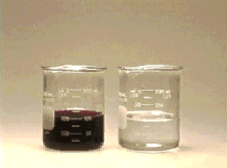
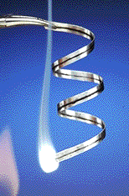
Oxidation-Reduction Reactions: An Introduction
Two examples of oxidation-reduction or redox reactions.
KMnO₄ and Fe²⁺
  Fe²⁺ is oxidized to Fe³⁺
  MnO₄¹⁻ is reduced to Mn²⁺
Combustion reactions are redox reactions
Combustion of Mg
  Mg is oxidized to MgO
  O₂ is reduced to O²⁻
Notes:
41
41

Slide 109
Oxidation-Reduction Reactions: An Introduction
Example 4-2: Write and balance the formula unit, total ionic, and net ionic equations for the oxidation of sulfurous acid to sulfuric acid by oxygen in acidic aqueous solution.
Formula unit equation
Total ionic equation
  You do it!
Notes:
41
41

Slide 110
Oxidation-Reduction Reactions: An Introduction
Net ionic equation
  You do it!
Which species are oxidized and reduced?
Identify the oxidizing and reducing agents.
  You do it!
Notes:
41
41

Slide 111
Oxidation-Reduction Reactions: An Introduction
H₂SO₃ is oxidized.
  The oxidation state of S in H₂SO₃ is +4.
  In SO₄²⁻, S has an oxidation state of +6.
O₂ is reduced.
  Oxidation state of O in O₂ is 0
  In SO₄²⁻, O has an oxidation state of –2.
H₂SO₃ is reducing agent.
O₂ is oxidizing agent.
Notes:
41
41

Slide 112
Combination Reactions
Combination reactions occur when two or more substances combine to form a compound.
There are three basic types of combination reactions.
  Two elements react to form a new compound
  An element and a compound react to form one new compound
  Two compounds react to form one compound

Slide 113
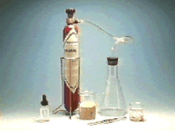
Combination Reactions
Element + Element → Compound
  Metal + Nonmetal → Binary Ionic Compound

Slide 114
Combination Reactions
Element + Element → Compound
  Metal + Nonmetal → Binary Ionic Compound

Slide 115
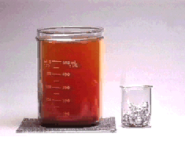
Combination Reactions
Element + Element → Compound
  Metal + Nonmetal → Binary Ionic Compound

Slide 116
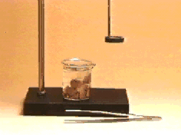
Combination Reactions
Element + Element → Compound
  Nonmetal + Nonmetal → Covalent Binary Compound

Slide 117
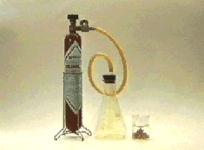
Combination Reactions
Element + Element → Compound
  Nonmetal + Nonmetal → Covalent Binary Compound

Slide 118
Combination Reactions
Element + Element → Compound
  Nonmetal + Nonmetal → Covalent Binary Compound
    Can control which product is made with the reaction conditions.

Slide 119
Combination Reactions
Element + Element → Compound
  Nonmetal + Nonmetal → Covalent Binary Compound
    Can control which product is made with the reaction conditions.

Slide 120
Combination Reactions
Compound + Element → Compound

Slide 121
Combination Reactions
The reaction of oxygen with oxides of nonmetals is an example of this type of combination reaction.

Slide 122
Combination Reactions
Compound + Compound → Compound
  gaseous ammonia and hydrogen chloride
  lithium oxide and sulfur dioxide

Slide 123
Decomposition Reactions
Decomposition reactions occur when one compound decomposes to form:
  Two elements
  One or more elements and one or more compounds
  Two or more compounds

Slide 124
Decomposition Reactions
Compound → Element + Element
  decomposition of dinitrogen oxide
decomposition of calcium chloride
decomposition of silver halides

Slide 125
Decomposition Reactions
Compound → One Element + Compound(s)
  decomposition of hydrogen peroxide

Slide 126
Decomposition Reactions
Compound → Compound + Compound
  decomposition of ammonium hydrogen carbonate

Slide 127
Displacement Reactions
Displacement reactions occur when one element displaces another element from a compound.
  These are redox reactions in which the more active metal displaces the less active metal of hydrogen from a compound in aqueous solution.
  Activity series is given in Table 4-14.
Notes:
42
42

Slide 128
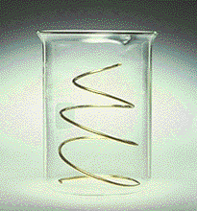
Displacement Reactions
[More Active Metal + Salt of Less Active Metal] → [Less Active Metal + Salt of More Active Metal]
  molecular equation
Notes:
42
42

Slide 129
Displacement Reactions
Total ionic equation
  You do it!
Net ionic equation
  You do it!
Notes:
42
42

Slide 130
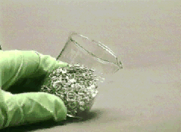
Displacement Reactions
[Active Metal + Nonoxidizing Acid] → [Hydrogen + Salt of Acid]
  Common method for preparing hydrogen in the laboratory.
  HNO₃ is an oxidizing acid.
Molecular equation
Notes:
45
45

Slide 131
Displacement Reactions
Total ionic equation
  You do it!
Net ionic equation
  You do it!
Notes:
46
46

Slide 132
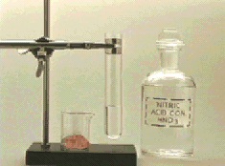
Displacement Reactions
The following metals are active enough to displace hydrogen
  K, Ca, Na, Mg, Al, Zn, Fe, Sn, & Pb
Notice how the reaction changes with an oxidizing acid.
  Reaction of Cu with HNO₃.
    H₂ is no longer produced.
Notes:
47
47

Slide 133
Displacement Reactions
[Active Nonmetal + Salt of Less Active Nonmetal] → [Less Active Nonmetal + Salt of More Active Nonmetal]
Molecular equation
Total ionic equation
  You do it!

Slide 134
Displacement Reactions
Net ionic equation
  You do it!
Notes:
48
48

Slide 135
Metathesis Reactions
Metathesis reactions occur when two ionic aqueous solutions are mixed and the ions switch partners.
  AX + BY → AY + BX
Metathesis reactions remove ions from solution in two ways:
  form predominantly unionized molecules like H₂O
  form an insoluble solid
Ion removal is the driving force of metathesis reactions.
Notes:
30
30

Slide 136
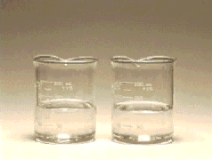
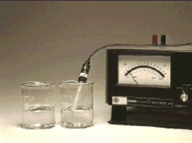

Metathesis Reactions
Acid-Base (neutralization) Reactions
  Formation of the nonelectrolyte H₂O
  acid + base → salt + water
Notes:
30
30

Slide 137
Metathesis Reactions
Molecular equation
Total ionic equation
  You do it!
Net ionic equation
  You do it!
Notes:
30
30

Slide 138
Metathesis Reactions
Molecular equation
Total ionic equation
  You do it!
Net ionic equation
  You do it!
Notes:
33
33

Slide 139


Metathesis Reactions
Precipitation reactions are metathesis reactions in which an insoluble compound is formed.
  The solid precipitates out of the solution much like rain or snow precipitates out of the air.
Notes:
26
26

Slide 140
Metathesis Reactions
Precipitation Reactions
Molecular equation
Total ionic reaction
  You do it!
Notes:
26
26

Slide 141
Metathesis Reactions
Net ionic reaction
  You do it!
Notes:
28
28

Slide 142
Metathesis Reactions
Molecular equation
Total ionic reaction
  You do it!
Notes:
26
26

Slide 143
Metathesis Reactions
Net ionic reaction
  You do it!
Notes:
28
28

Slide 144
Metathesis Reactions
Molecular equation
Total ionic reaction
  You do it!
Notes:
26
26

Slide 145
Metathesis Reactions
Net ionic reaction
  You do it!
Notes:
28
28

Slide 146
Synthesis Question
Barium sulfate is a commonly used imaging agent for gastrointestinal X-rays. This compound can be prepared by some of the simple reactions described in this chapter. Write a balanced aqueous reaction for the production of barium sulfate. You can choose any aqueous starting materials that will form barium sulfate!
Notes:
68

Slide 147
Synthesis Question
Find two aqueous soluble compounds that have Ba in one compound and SO₄²⁻ in the second. When they are mixed, the barium sulfate will precipitate out. One possibility is:
Notes:
69

Slide 148
Group Activity
Pretend that you are one of our lab TA’s and that you have been given the assignment to prepare unknowns for a qualitative analysis experiment. In a single solution you must have the following ions: Bi³⁺, Cd²⁺, and Cu²⁺. You must make this solution using three different anions. What three compounds would you choose to make this solution so that no precipitate forms?
Notes:
70

Slide 149
End of Chapter 4
Notes:
71
71

